Slide 1
GIS Data Input

Slide 2
Data in GIS
Data is one of the major components of GIS.
GIS is primarily concerned with spatial data.
Understanding a geographic phenomena depends on how well the data is modelled.
Remember, Garbage in Garbage out. Poor data means the result of the analysis done using GIS is also poor.
Data collection is one of the most expensive process. And, hence a large number of companies have invested heavily resulting in innovative technologies for data collection.

Slide 3
Data Sources
Primary Data:
Data obtained from first hand sources
Collected with focus on the objectives of data collection (eg: for particular research purpose)
Secondary Data : Data obtained from pre-existing sources

Slide 4
Discuss the pros and cons of direct and indirect data acquisition.

Slide 5
Data Sources and data acquisition in GIS

Slide 6
Ground Survey | Field based measurements

Slide 7
Ground Survey | Field based measurements
Ground survey is one of the most reliable sources of data.
However, it can be time consuming and equally costly.
Ground based surveys have been made more efficient and effective with tremendous improvements in the instruments used for such surveys.
Surveying instruments are digital with facility of digital display, automatic computations and data storage.

Slide 8
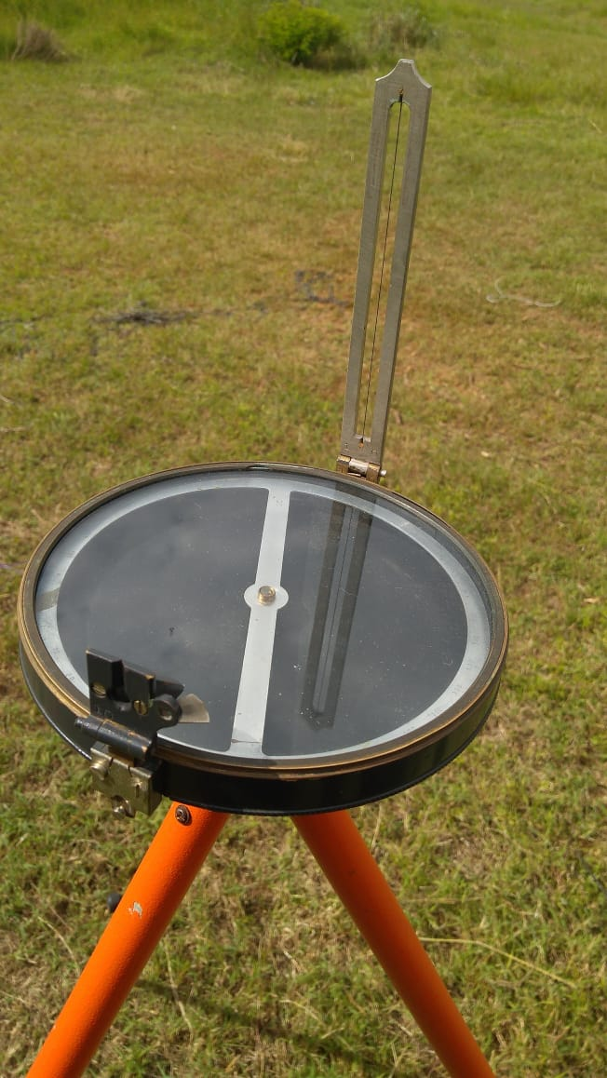
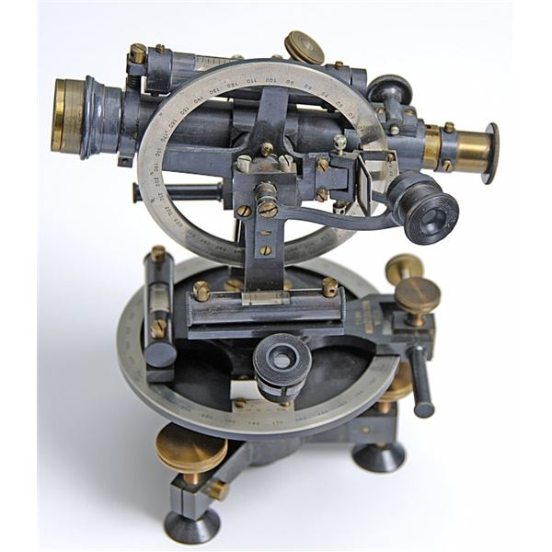
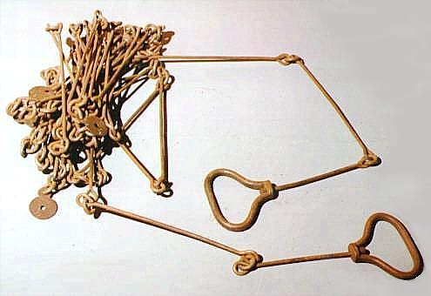
Ground Survey | Field based measurements
Chain, Tape, Compass, Theodolite

Slide 9
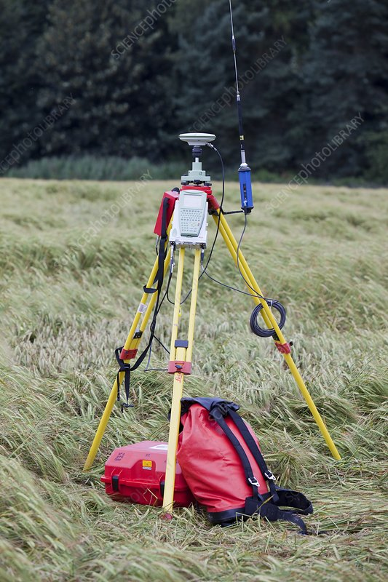
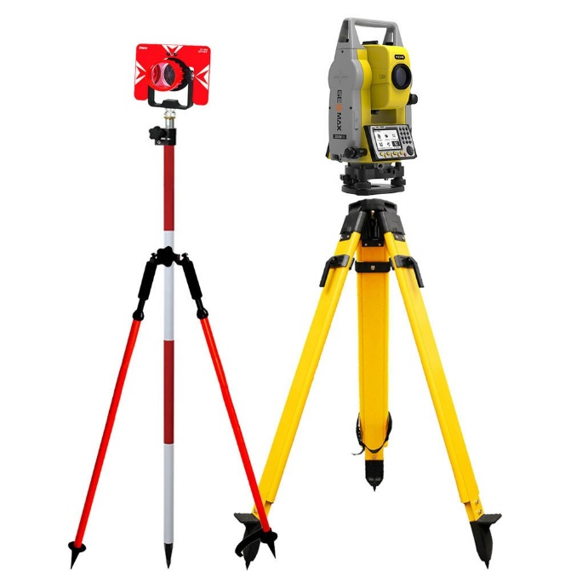
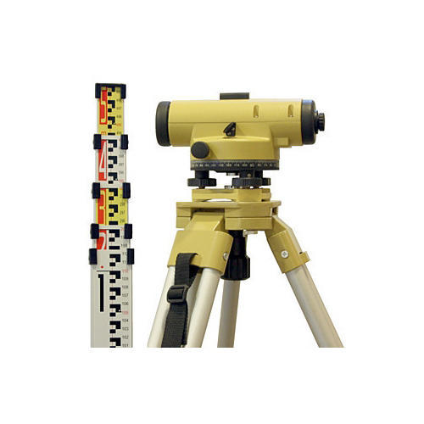
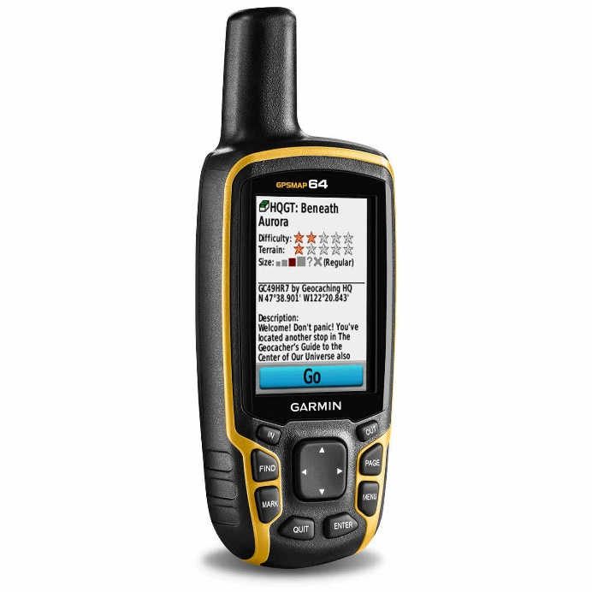
Ground Survey | Field based measurements
Level, Total Station, GPS

Slide 10
Remote Sensing Based Measurements

Slide 11
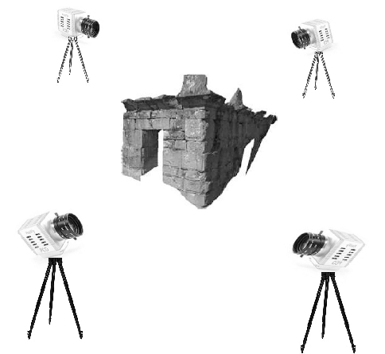
Terrestrial Photogrammetry (also called close-range photogrammetry)
Based on principle of stereo-vision
Overlapping photos are taken from different positions surrounding an object of interest
Popular method in archiving of historical and cultural monuments
https://sketchfab.com/3d-models/kal-bhairav-kathmandu-0db5beb3c6cb45f2b6c3fb63cc342044

Slide 12
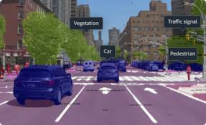
Terrestrial Photogrammetry (also called close-range photogrammetry)
Platforms like mapillary has redefined the meaning of terrestrial photogrammetry using machine learning for object detection.
Link : www.mapillary.com

Slide 13
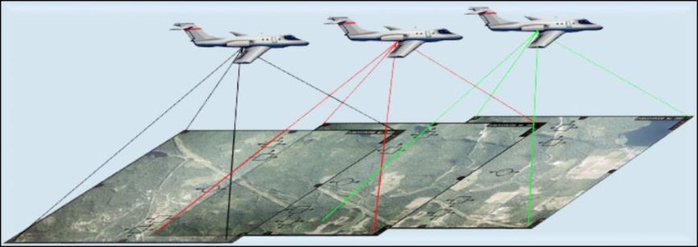
Photogrammetry from Aerial Platforms
The topographic maps of Nepal are prepared based on analog aerial photogrammetry.
Now, photogrammetry is exclusively done in digital systems.

Slide 14
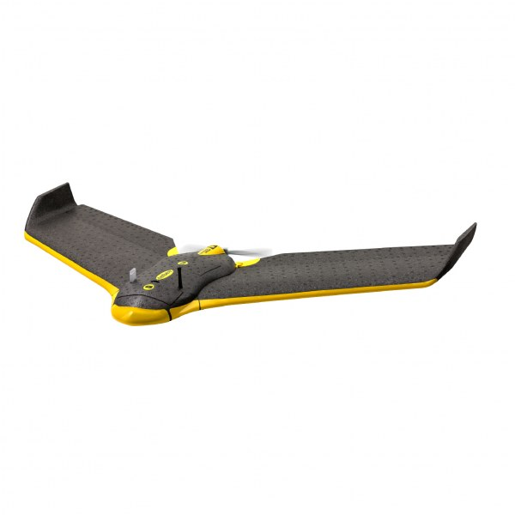
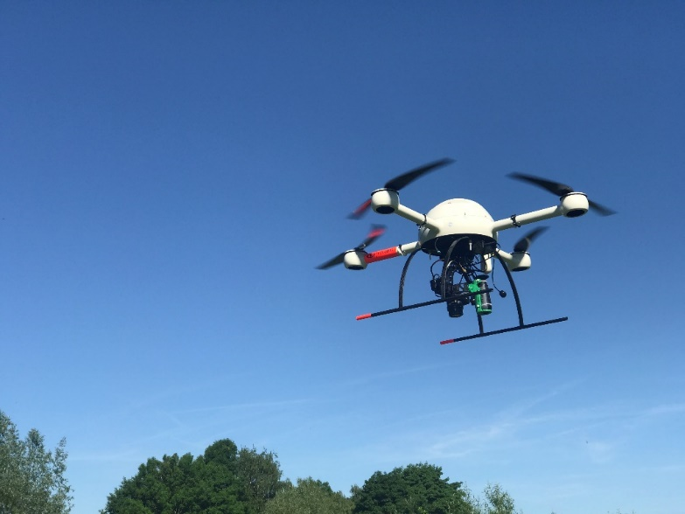
Unmanned Aerial System
UAVs (commonly known as drones) are technologies that have caused paradigm shift in mapping providing a low-cost method for surveying and mapping.
Rotary Wings Based
Fixed Wing Based
https://www.youtube.com/watch?v=QXkcvzxBsrY

Slide 15
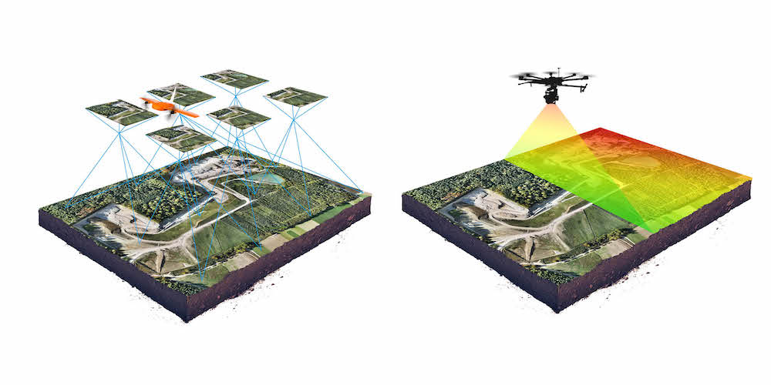
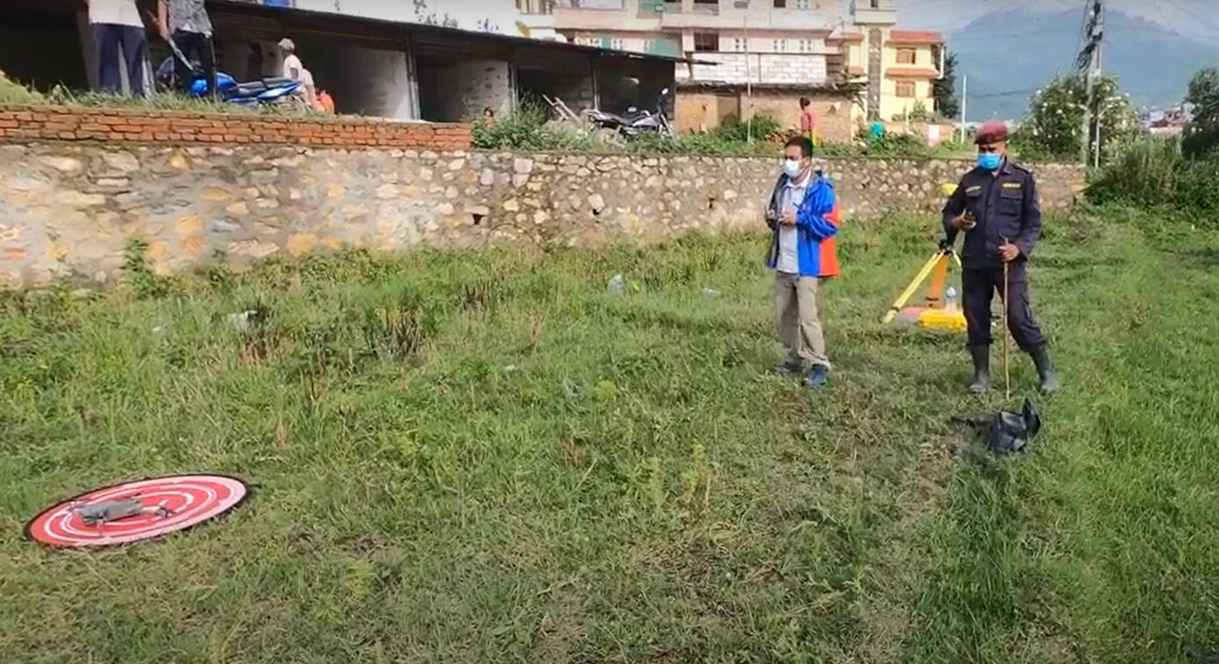
Applications of UAS based mapping
Humanitarian Mapping
Topographic Mapping
Cadastral Mapping
Cultural Heritage Mapping

Slide 16
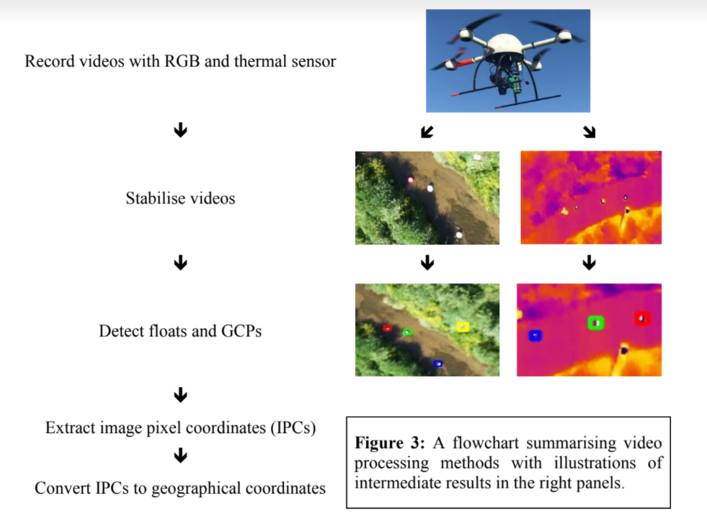
Applications of UAS based mapping
Measuring river velocity

Slide 17
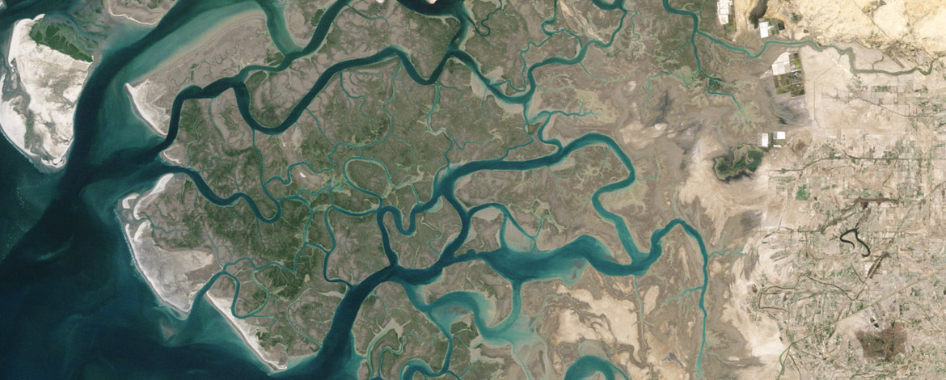
Satellite Imagery
Huge number of Earth Observation Satellites are launched which has made regular data collection possible from huge area.

Slide 18
LIDAR Technology

Slide 19
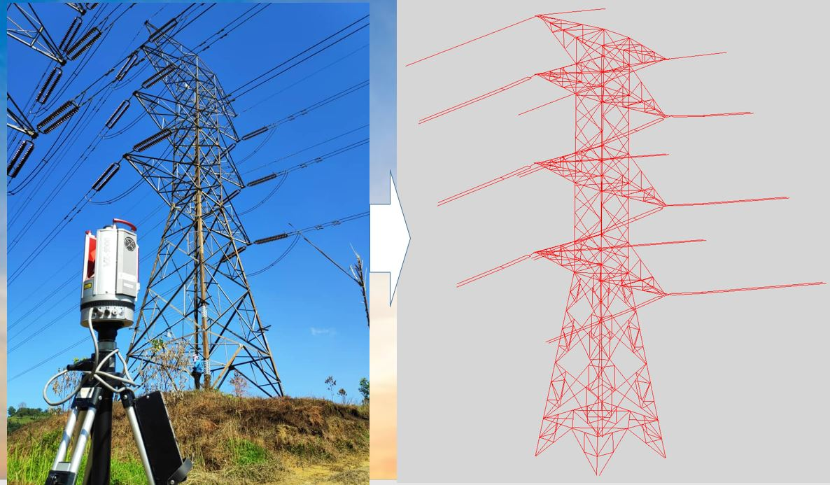
Terrestrial Lidar (Laser Scanners)

Slide 20
UAV based LIDAR

Slide 21
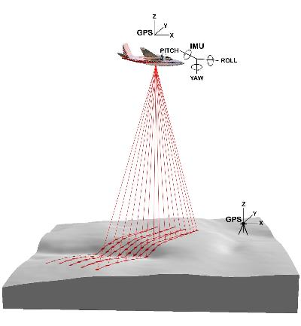
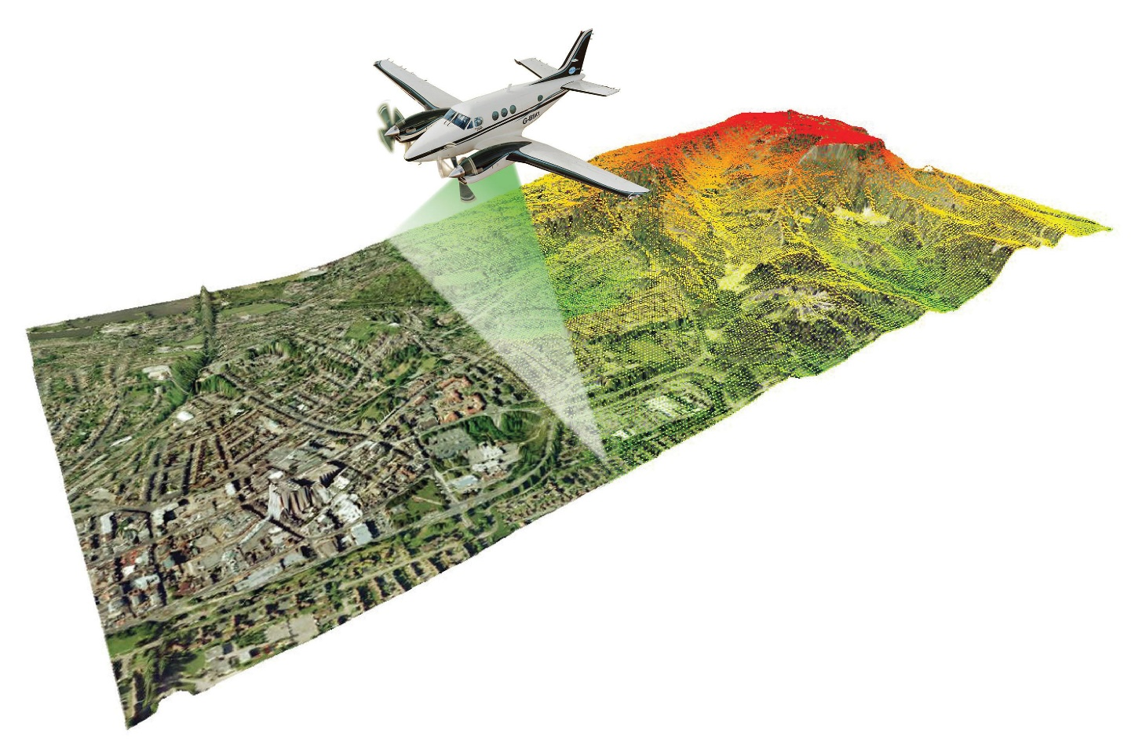
LIDAR on Planes

Slide 22
Digitizing Hardcopy Maps
Hardcopy maps in paper, cloth, etc. are sources of historical spatial information
These are useful when comparative study are done.
cost-effective indirect method of data
capture is the DIGITISING of existing maps.
requires the conversion of an analogue map into a digital map.

Slide 23
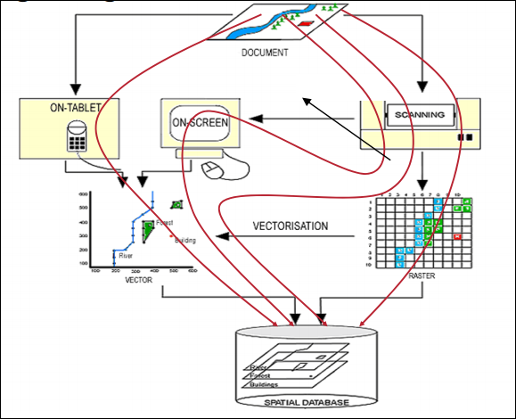
Digitizing Process

Slide 24
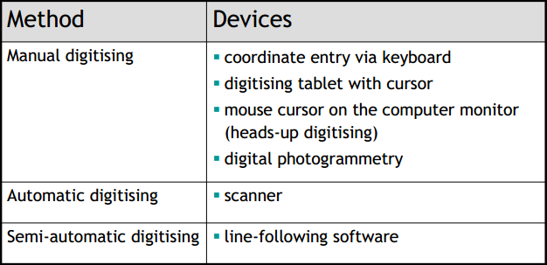
Digitizing techniques

Slide 25
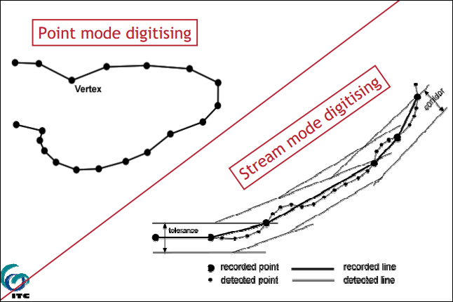
Point & Stream Mode Digitizing

Slide 26
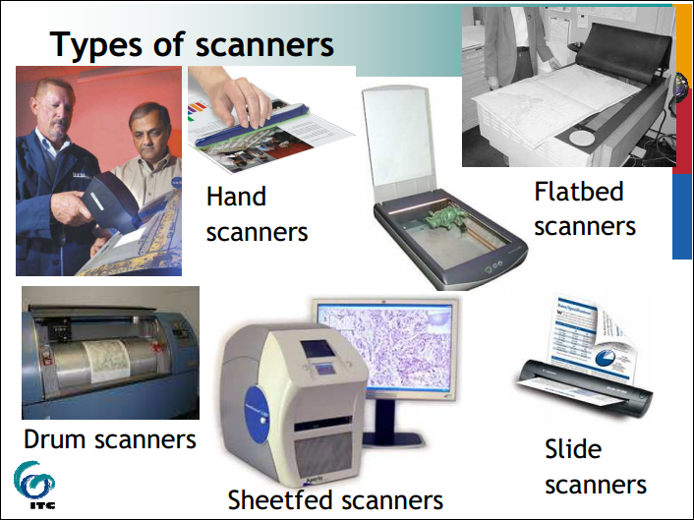

Slide 27
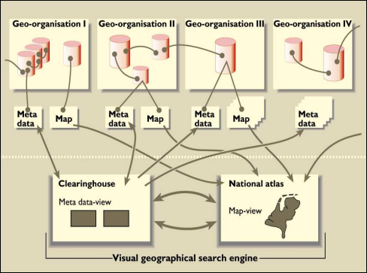
Spatial Data Clearinghouses

Slide 28
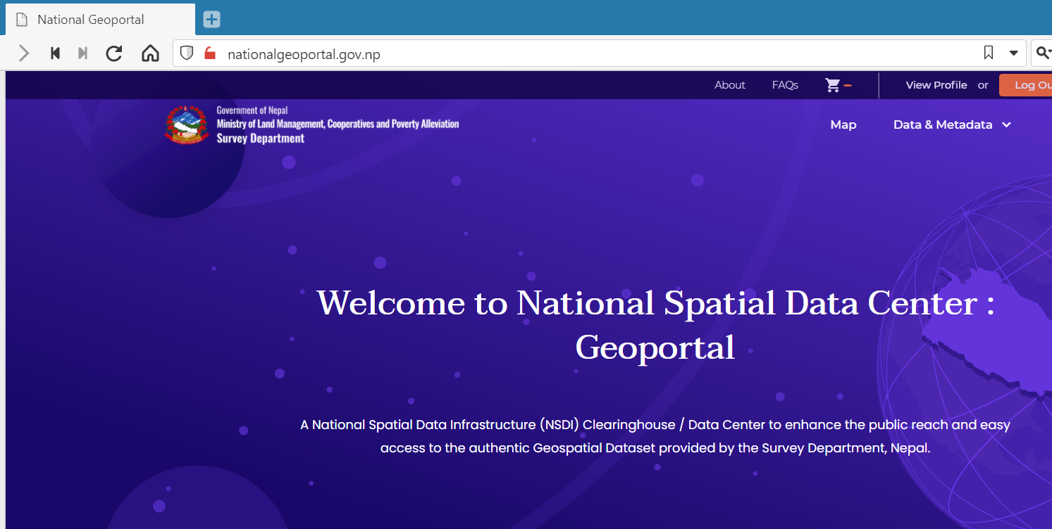
Spatial Data Clearinghouses
nationalgeoportal.gov.np

Slide 29
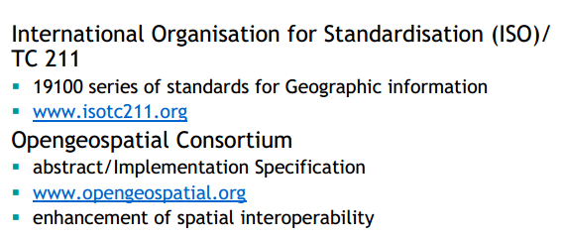
Data Standards

Slide 30
Summary
Data is one of the most important components of GIS.
Collecting data is the most challenging part in GIS.
As a GIS user, you must keep yourself updated on your field of work.
Always keep exploring…….

Slide 31
End of Session
GIS Data Input

